Slide 1


PRODUCT NAME:
MOSQUITOES AND INSECTS
KILLING MACHINE
Year -2019 - 2020
Section -D
Batch -2
Group -10
Team members – 5
Roll no.s. Name
19K41A04B6 S.AMULYA
19K41A04B5 S.NIKITHA
19K41A04B4 SNEHA REDDY
19K41A05B1 SHIVA KEERTHI
19K41A05B2 SAI DEV

Slide 2
Domain/ Design Space
DOMAIN:
Health care and comfort.
There are other domains we could work on such as effortless living,
outdoor living, health care for elderly and children, comfort, etc.
However, we selected health care and comfort to make our product
for better living standards of people.

Slide 3
Ethnographic Study/Observations
Gains
Pains
It works only with power supply.
Easy to use.
It can be used both indoors and outdoors.
It is portable
Low maintenance.
No health hazard, environment friendly.
It is light in weight
Affordable price
Requires minimum human effort

Slide 4
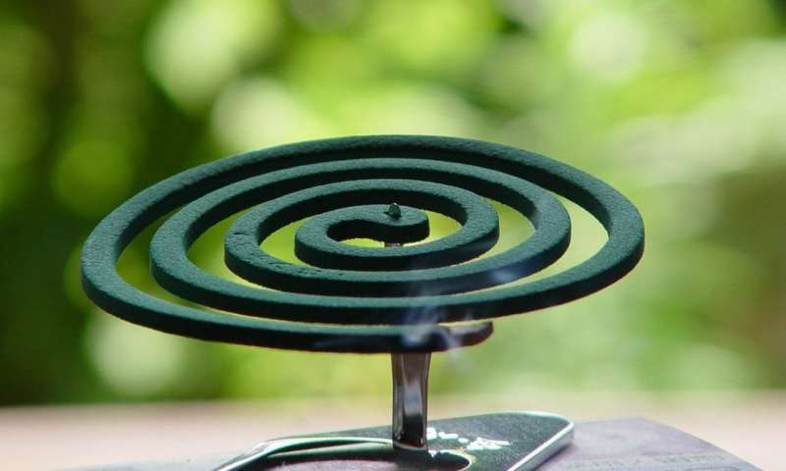
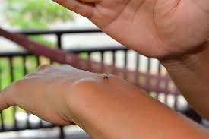
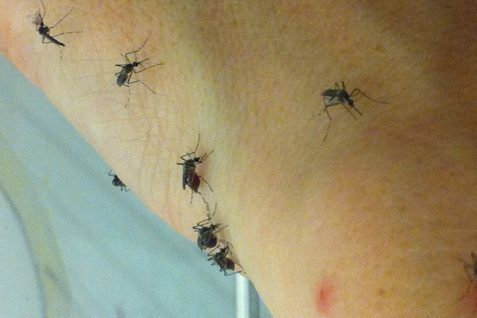
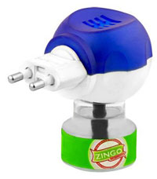
Problem Statement
In our day to day lives, killing mosquiotoes and insects manually is a hectic task. Eventhough we have mosquito coils and vapour emitting machines, they are harmful for our lungs.

Slide 5
Need Statement
To overcome this problem, we have come to a conclusion that we need a product which can kill mosquitoes without any human effort. We need a product which does not harm our health and is comfortable to use.

Slide 6
Exploration/ Prior Art Search
All the existing products to kill insects are either human effort dependent or harmful to our health.
The product we are about to design should be capable of killing mosquitoes and insects
without any health harm or effort to humans.
This can be achieved through electricity. We can zap the mosquitoes to kill them.
We already have mosquito bats which involves human effort to kill.
But we should not involve any human effort, that means, we need to create a machine
which can automatically kill mosquitoes and insects.
To achieve this, we can incorporate an electric net in a cardboard box and give electric supply.
But this is not enough to get the mosquitoes closer to the machine.
So, we need to attract the insects.
As we all know that insects can be easily attracted towards light, we can attach
a light inside the cardboard box to lure them in and then they can easily get killed.

Slide 7
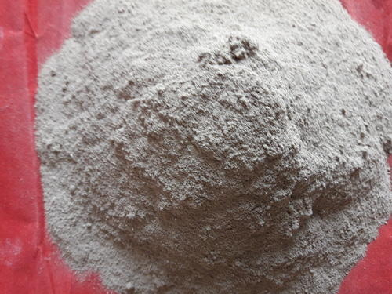
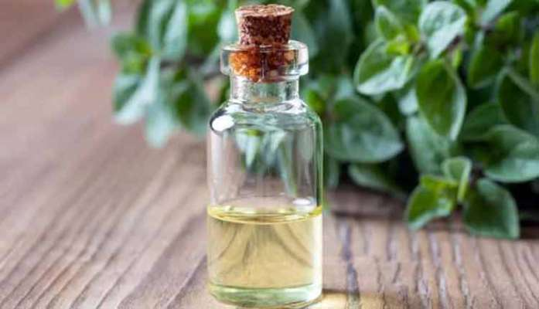
Concepts Generated using SCAMPER concept 1:
Images of concept 1
Substitute: we can substitute the
harmful chemicals in coils with
organic and natural materials.
Modify: we can modify the
Composition with natural oils
in vapor emitting machines such
that they are harmless to humans.
S - substitute
C - combine
A - adapt
M - modify
P - put to other use
E - eliminate
R - rearrange/reverse

Slide 8
Concepts Generated using SCAMPER concept 2:
Combine: we can combine the ideas of
electric bat and mosquito
repelling vapor emitting machine.
Adapt: we can use light to lure the mosquitoes into the electric net of the machine.
Put to use: we can put to use an
old dysfunctional electric bat
Eliminate: we can eliminate the lower
portion of the electric bat and
use the upper net.
Rearrange: we should
rearrange the circuit of the electric net
inside the cardboard box.
S - substitute
C - combine
A - adapt
M - modify
P - put to other use
E - eliminate
R - rearrange/reverse

Slide 9
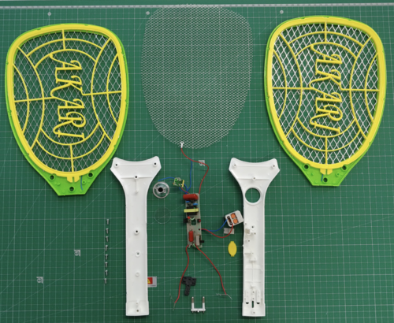
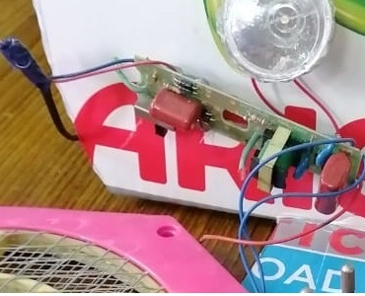
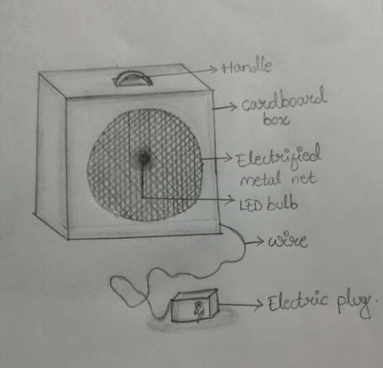
Images of concept 2

Slide 10
Concept Selection
We selected concept 2 because it is:
Feasible
Materials are easily available
Affordable
Practical and workable

Slide 11
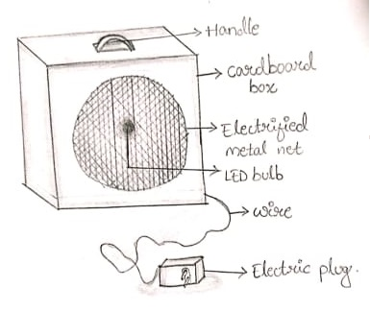
Final Designed concept with a detailed sketch
Sketch:

Slide 12
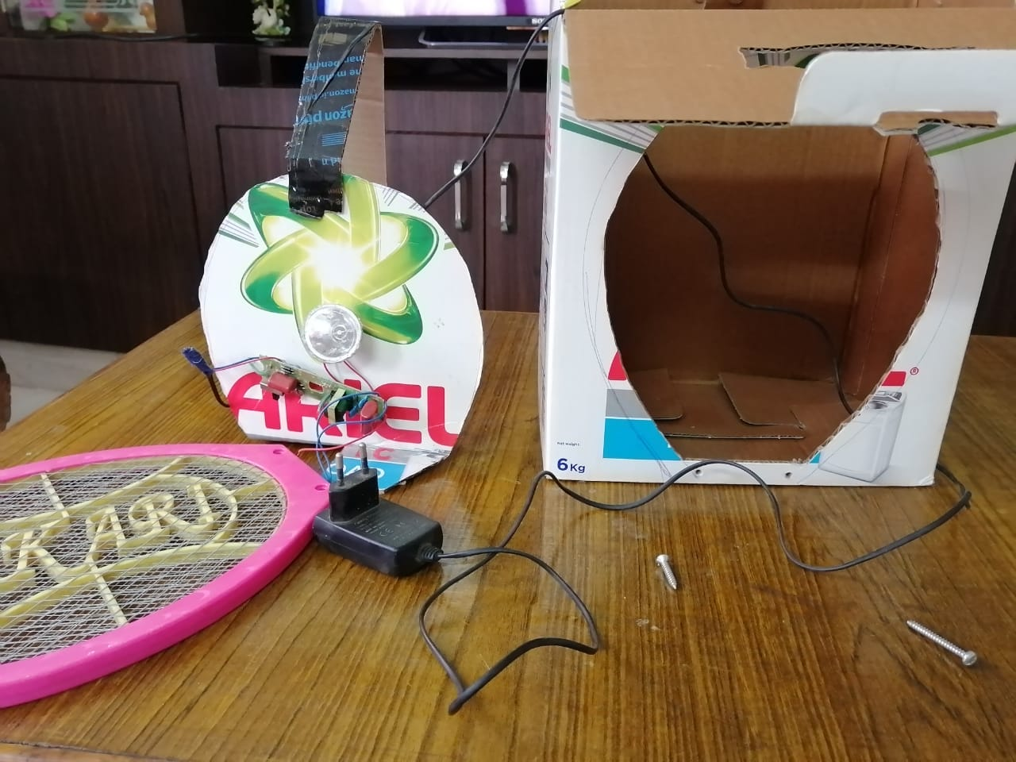
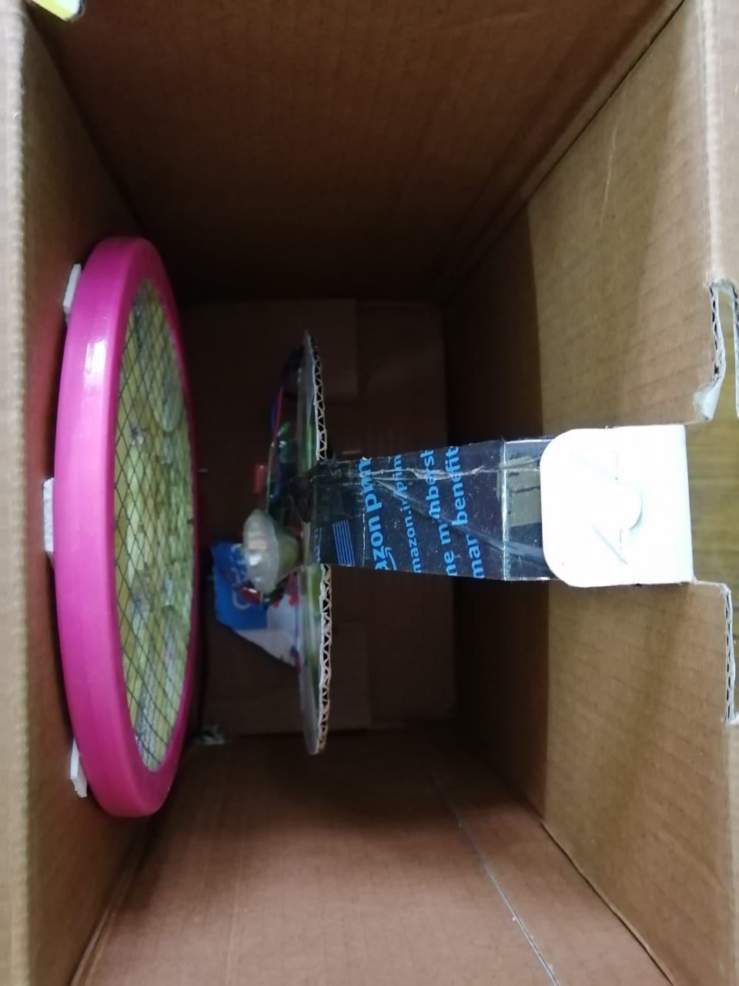
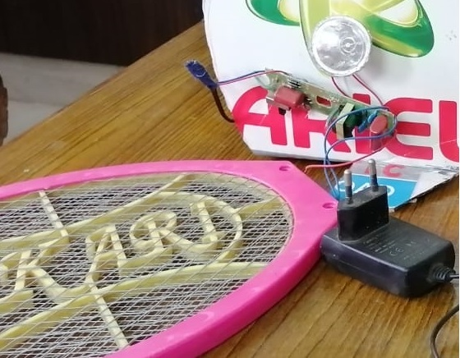
Product Decomposition
Exploded image of the product
Physical decomposition:
We have used cardboard box as the
outer covering, inside the cardboard box
we have arranged electric net connected
to the circuit. This circuit also connects an
LED bulb and a wire is sent out of the box.
Functional decomposition: The wire which comes out of the box is
connected to a plug and it is put in a
switch board, when the current is passed,
the circuit inside the box becomes active
and electricity passed through the metallic
net arranged at to the cardboard.

Slide 13
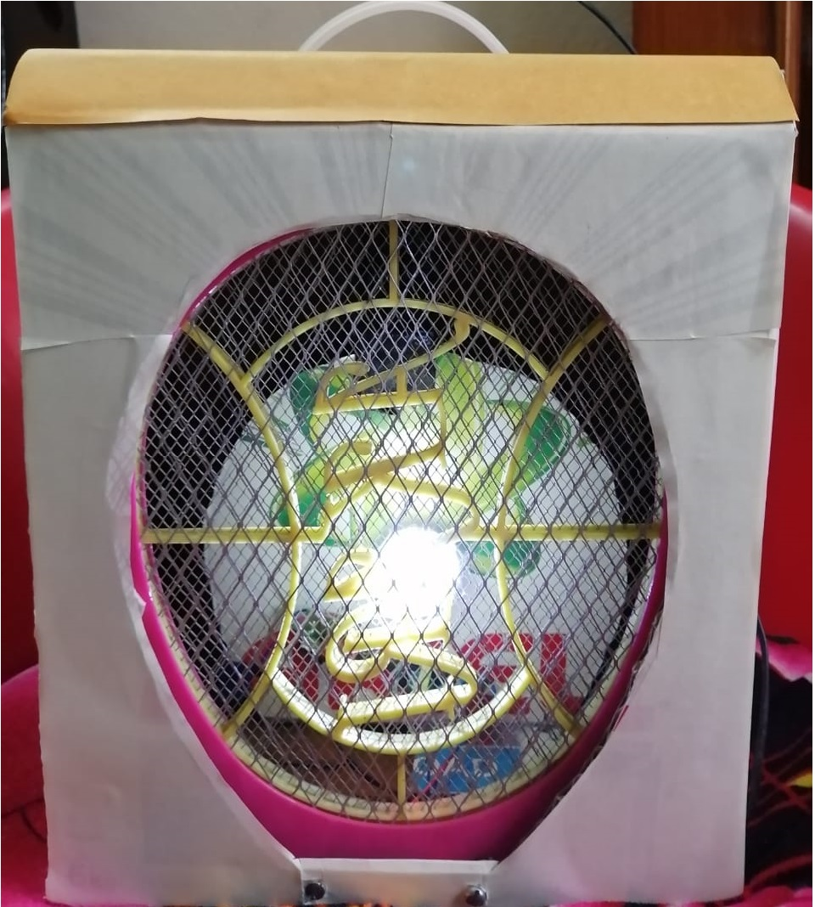
Product Woking Manual - Storytelling
Step 1
Step 2
cc
Step 3
cc
cc
Step 4

Slide 14
Bill of Materials / Future Scope
Approximate Product Cost (along with Individual Materials and production costs)
Future Scope and Improvements
We can include a battery such
that the machine works without
power supply.
We can use wood instead of
cardboard for more strength
and durability.
Cost of 4.5 volt DC adapter=450/-
Miscellaneous=20/-
Total cost=470/-

Slide 15
Thank You

